Slide 1
AUDIO INPUT AND DISPLAY ON THE VGA
Morayo Ogunsina & Nadira Badrul
2B
CMPEN371

Slide 2
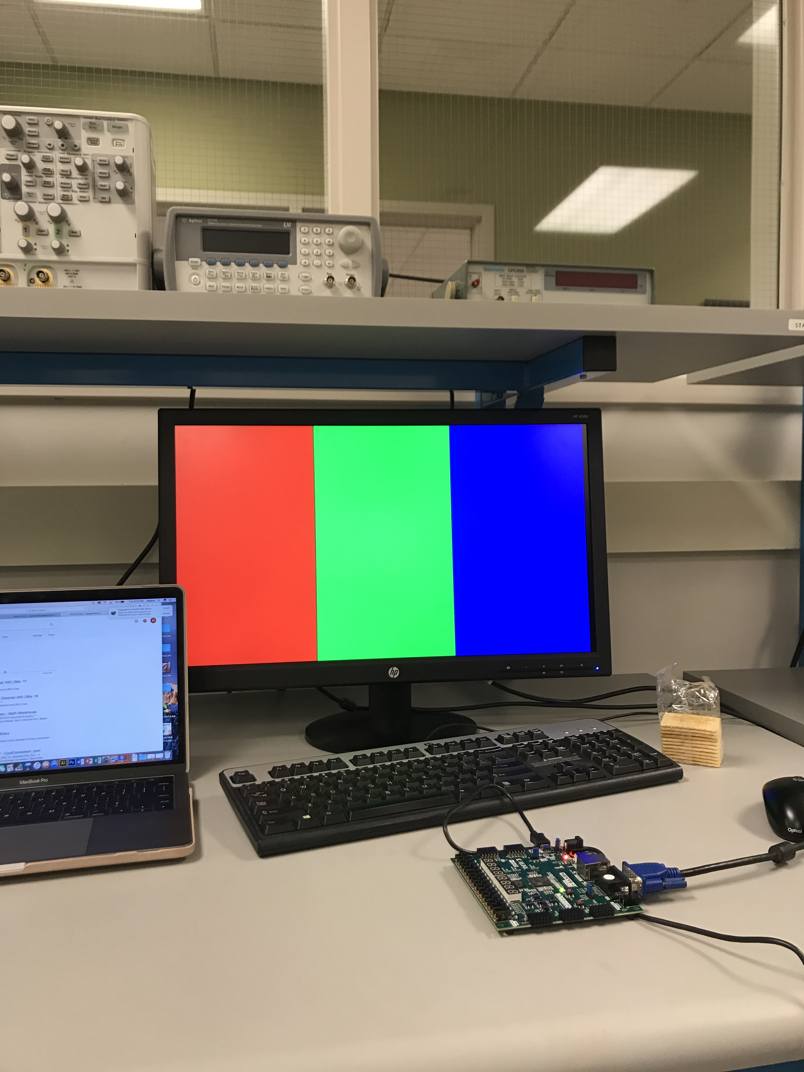
PROJECT IDEA
0101011010…
Audio Input Data
NEXYS4-DDR Board
VGA Display

Slide 3
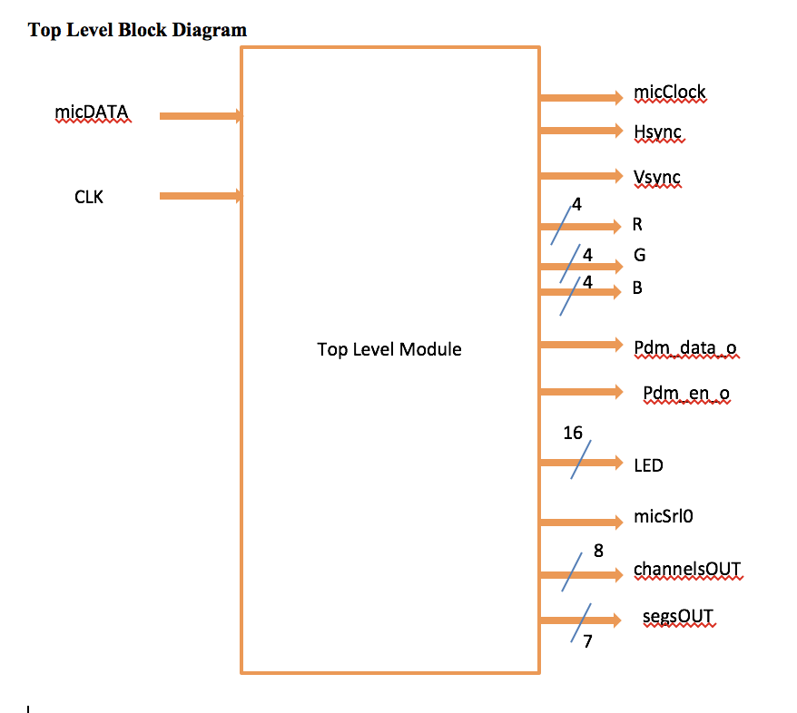
TOP LEVEL DESIGN ARCHITECTURE
micDATA: 1 bit input data from the board microphone
CLK : 100MHz board clock
micClock: Clock input to microphone at 3.072 MHz
micSrl0: A low level on L/RSEL makes data available on the rising edge of the clock. ‘0’
Hsync & Vsync : VGA drive signals
R,G, B: rgb color components of the vga
LED: mic audio debug signals
segsOUT: seven segment digit
channelsOUT: anode of each seven segment
Pdm_data_o: output audio
Pdm_en_o : output audio enable signal

Slide 4
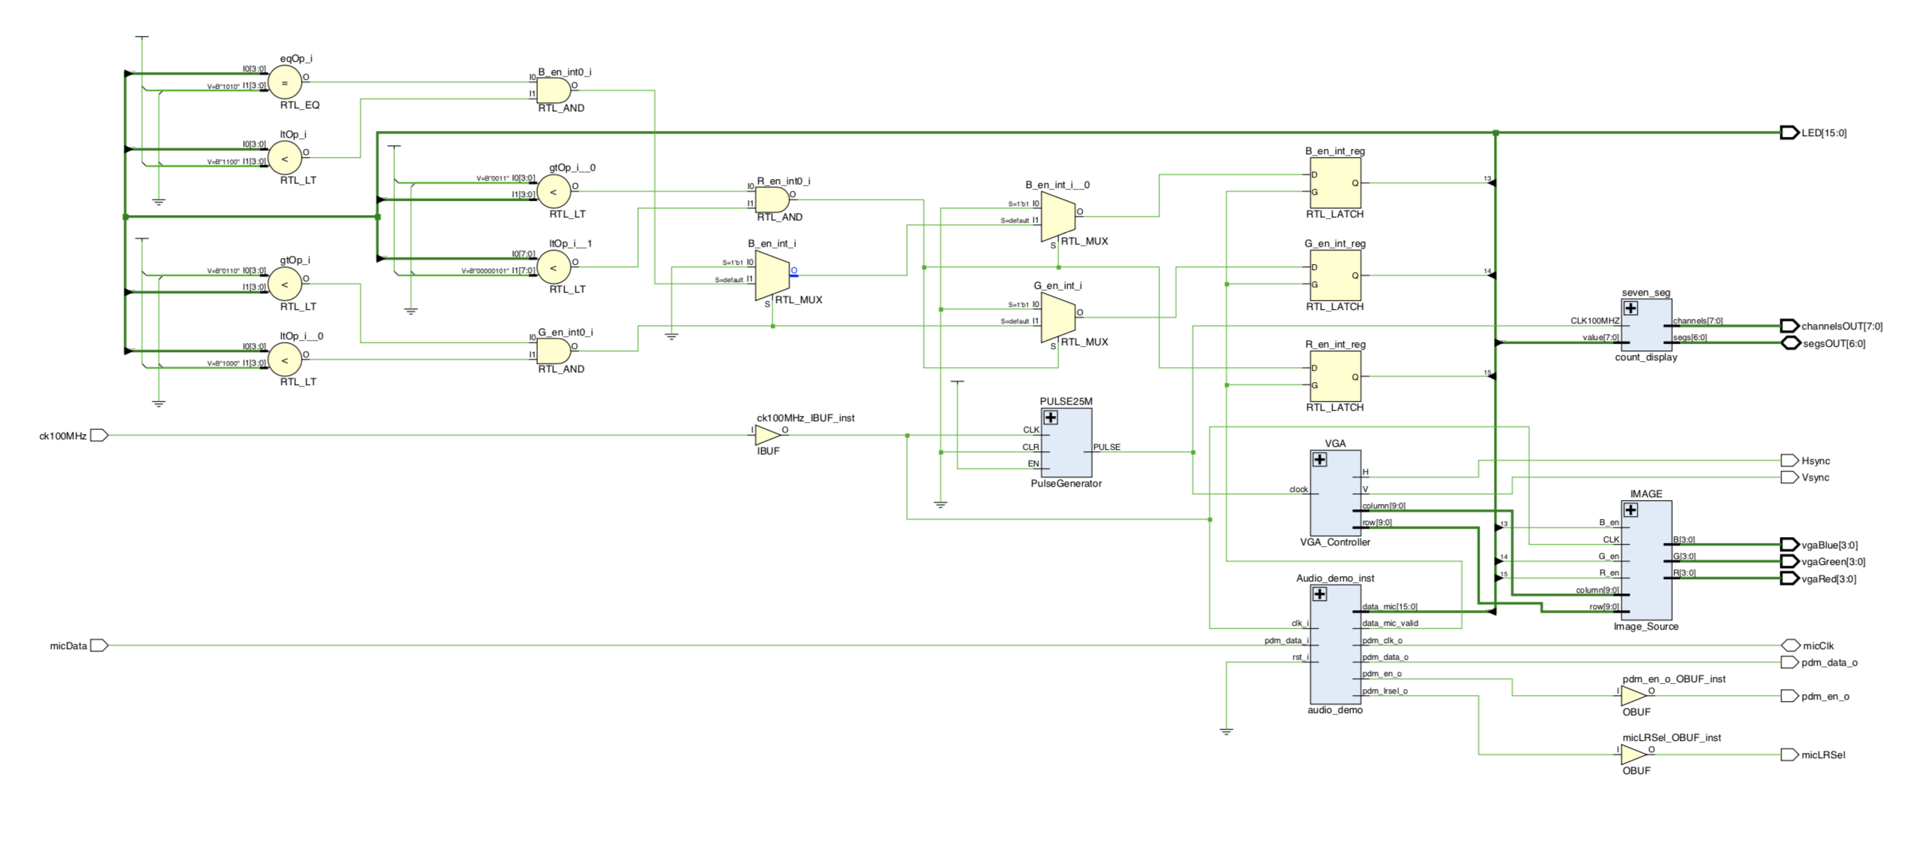
SCHEMATIC

Slide 5
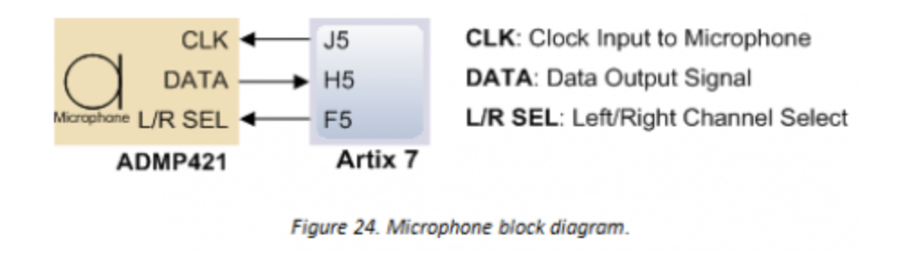
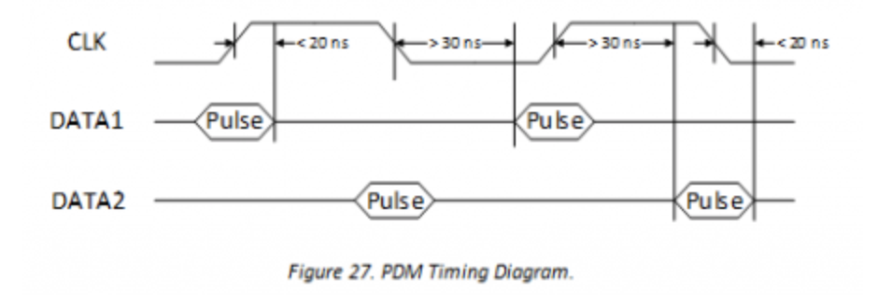
Getting Audio Input
CLK input of microphone is 3.072MHz (can range from1MHz – 3.3MHz) with sampling rate of 48KSPS
The PDM signal of microphone input is filtered and decimated to a 48KHz, 16 bits audio string.
Notes:
Range is usually 1MHz to 3.3MHz
The PDM signal of the microphone is filtered and decimated to a 48KHz, 16 bit audio sample string.

Slide 6
3.072MHz mic clock
Set L/R SEL =‘0’
Deserializing pdm data (1bit) input to minimum of 8 bits
Bit 8 downto 1 is not mic data while bit 0 is micdata from pdm (M)
CIC
Halfband filter
Lowpass Filter
Highpass Filter
3.072Mhz 8 bits
192 kHz
24 bits
192 kHz
Input sampling rate 24 bit
Decimates to 96kHz output sampling rate 24 bits
No decimation
24 bits symmetric value
96 kHz 24 bits
Data_out
96 kHz
16 bits
*removes any dc componenet
16 downto 1
Divided to 48 kHz

Slide 7
DISPLAY ARCHITECTURE
Uses a 640 x 480 resolution at 25Mhz pixel clock.
3 enable signals are used to enable the blocks based on how loud the audio input is.
0
(213,0)
(426,0)
640,0
(0,480)
(213,480)
(426,480)
(640,480)

Slide 8
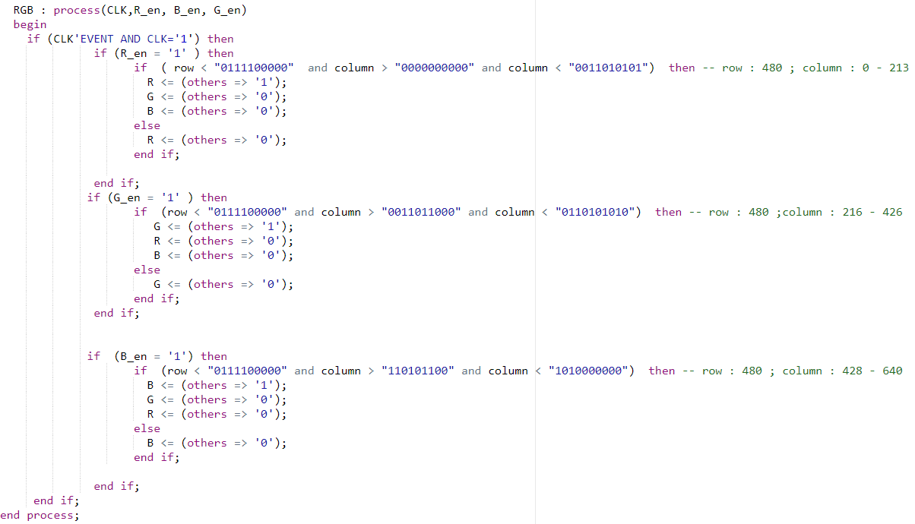
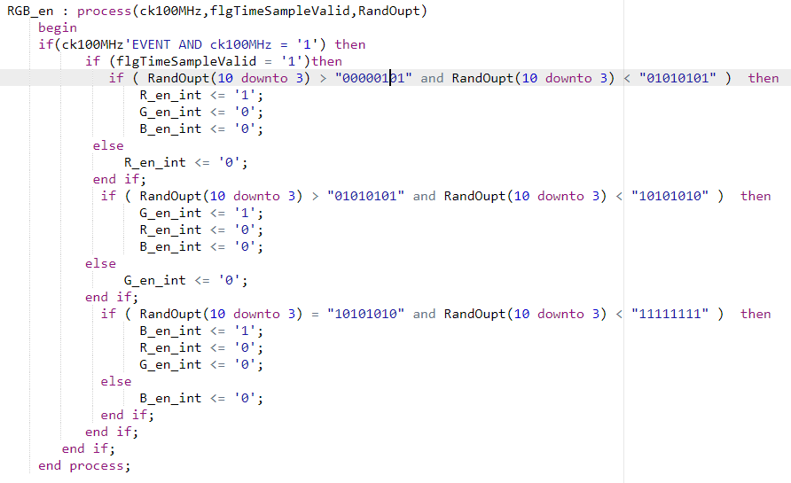
CODE SNIPPETS

Slide 9
CHALLENGES
Getting the blocks to display properly
without flashing.
DEBUGGING
Filtered audio output can be heard through an earphone.
The first 12 bits of the output is to the LEDs; enable signals for R, G, B blocks are wired to LED(15..13).
The 16 bit audio data is displayed on the seven segment.

Slide 10
REFERENCES
NEXYS SPECTRAL SOURCES SOURCE CODE :
https://reference.digilentinc.com/learn/programmable-logic/tutorials/nexys-4-ddr-spectral-sources-demo/start
VGA Display http://www.ece.ualberta.ca/~elliott/ee552/studentAppNotes/1998_w/Altera_UP1_Board_Map/vga.html
NEXYS 4 DDR Reference Manual
https://reference.digilentinc.com/reference/programmable-logic/nexys-4-ddr/reference-manual

